Slide 1


Roberto Sanz Lopes
13.12.2022

Slide 2

Outline
Executive Summary (page 3)
Introduction (page 4)
Methodology (page 5)
Results (page 16)
Conclusion (page 45)
Appendix (page 46)

Slide 3
Executive Summary
We obtained data from the public SpaceX API and Wikipedia page. We added a 'class' column that indicates the success of landings. We analyzed the data using SQL, visualizations, folium maps, and dashboards. We selected relevant columns to use as features. We converted all categorical variables to binary using one-hot encoding. We standardized the data and used GridSearchCV to find the optimal parameters for machine learning models. We visualized the accuracy of all models
We developed four machine learning models: Logistic Regression, Support Vector Machine, Decision Tree Classifier, and K Nearest Neighbors. All of the models performed similarly with an accuracy rate of approximately 83%. All of the models overestimated the number of successful landings. We believe that additional data is needed to improve the accuracy and effectiveness of our models.

Slide 4
Introduction
Project background and context
Space X has the most competitive pricing in the commercial space market, largely due to their ability to recover the first stage of their rocket. Space Y is looking to compete with Space X in this market.
Problems you want to find answers
Space Y has asked us to train a machine learning model to predict the success of the first stage recovery of their rocket.

Slide 5

Section 1

Slide 6
Methodology
Executive Summary
Data collection methodology:
The data for this model will be obtained from the SpaceX public API and the SpaceX Wikipedia page.
Perform data wrangling
The classification of true landings as successful and all others as unsuccessful will be used in this model.
Perform exploratory data analysis (EDA) using visualization and SQL
Perform interactive visual analytics using Folium and Plotly Dash
Perform predictive analysis using classification models
GridSearchCV will be used to fine-tune the models.

Slide 7
Data Collection
The data for this model will be collected using a combination of API requests from the SpaceX public API and web scraping data from a table on the SpaceX Wikipedia entry.
The columns for the API data include:
FlightNumber, Date, BoosterVersion, PayloadMass, Orbit, LaunchSite, Outcome, Flights, GridFins, Reused, Legs, LandingPad, Block, ReusedCount, Serial, Longitude, Latitude.
The columns for the webscrape data include:
Flight No., Launch site, Payload, PayloadMass, Orbit, Customer, Launch outcome, Version Booster, Booster landing, Date, Time.

Slide 8
Data Collection – SpaceX API
Request (Space X APIs)
Json_normalize to DataFrame data from JSON
JSON file + Lists
Filter data to get
the Falcon 9
launches
Create a Dataframe to work with the data
Dictionary
relevant
data
Lab 1 - Github link
Imputate missing PayloadMass values with mean

Slide 9
Data Collection - Scraping
process web
scraped HTML
table
Create a BeautifulSoup object from the HTML
Extract all column/variable names from the HTML
Cast dictionary to
DataFrame
Create dictionary
and extract Data
Create a data
frame by parsing
the launch HTML
tables
Lab 2 - Github link

Slide 10
Data Wrangling
To create a new training label column called 'class', a value could be assigned using the existing 'Mission Outcome' and 'Landing Location' columns. If 'Mission Outcome' was True, the value of 'class' could be set to 1. Otherwise, it could be set to 0. The following value mapping could be used:
True ASDS, True RTLS, & True Ocean -> 1
None None, False ASDS, None ASDS, False Ocean, False RTLS -> 0
In other words, if the 'Mission Outcome' was True and the 'Landing Location' was one of the specified values, the 'class' value would be set to 1. Otherwise, it would be set to 0.
Lab 2 - Github link

Slide 11
EDA with Data Visualization
In order to train a machine learning model, we performed Exploratory Data Analysis on several variables, including Flight Number, Payload Mass, Launch Site, Orbit, Class, and Year.
We used a variety of plots, such as scatter plots, line charts, and bar plots, to compare the relationships between these variables and determine if they could be useful in our model. Some of the specific plots we used were Flight Number vs. Payload Mass, Flight Number vs. Launch Site, Payload Mass vs. Launch Site, Orbit vs. Success Rate, Flight Number vs. Orbit, Payload vs Orbit, and Success Yearly Trend.
Lab 2 - Github link

Slide 12
EDA with SQL
The data set was imported into IBM DB2 Database, and SQL queries were used to gain insights and understand the dataset. The queries focused on retrieving information about launch site names, mission outcomes, pay load sizes and booster versions of customers, and landing outcomes.
Lab 2 - Github link

Slide 13
Build an Interactive Map with Folium
Folium maps were used to mark launch sites, successful and unsuccessful landings, and proximity to key locations such as railways, highways, coastlines, and cities. This helped us understand the reasons why launch sites may be located where they are, and also visualize the locations of successful landings.
Lab 2 - Github link

Slide 14
Build a Dashboard with Plotly Dash
Summarize what plots/graphs and interactions you have added to a dashboard
Explain why you added those plots and interactions
Add the GitHub URL of your completed Plotly Dash lab, as an external reference and peer-review purpose

Slide 15
Predictive Analysis (Classification)
Summarize how you built, evaluated, improved, and found the best performing classification model
You need present your model development process using key phrases and flowchart
Add the GitHub URL of your completed predictive analysis lab, as an external reference and peer-review purpose

Slide 16
Results
We ranked and localized in the dataframe the count of landing outcomes and found that most of them were successful. However, we also discovered relationships between failure and other variables.

Slide 17

Section 2

Slide 18
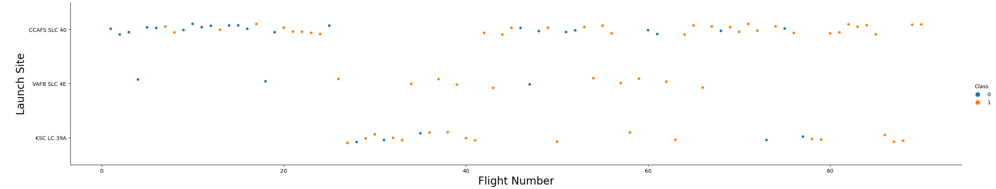
Flight Number vs. Launch Site
Orange indicates successful launch; blue indicates unsuccessful launch.
The graph shows that the success rate of flights has improved over time, with a noticeable increase starting at Flight 20. The majority of launches seem to take place at the CCAFS site, as indicated by the high volume of flights.

Slide 19
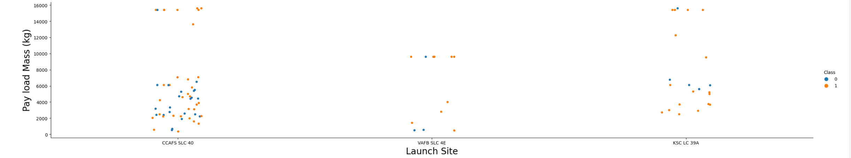
Payload vs. Launch Site
Orange indicates successful launch; blue indicates unsuccessful launch.
The payload mass for most launch sites appears to be in the range of 0 to 6000 kilograms. However, it seems that different launch sites may have varying payload mass limits.

Slide 20
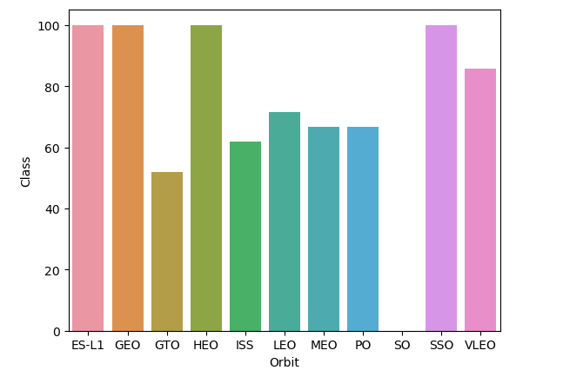
Success Rate vs. Orbit Type
The launch sites ES-L1, GEO, and HEO have all successfully completed 100% of their missions (sample sizes in parentheses: ES-L1: 1, GEO: 1, HEO: 1). SSO also has a 100% success rate with 5 missions.
VLEO has a decent success rate and a larger number of attempts (14 missions).
SO has not successfully completed any missions (1 attempt).
GTO has a success rate of around 50%, but it has the largest sample size among the launch sites (27 missions)."

Slide 21
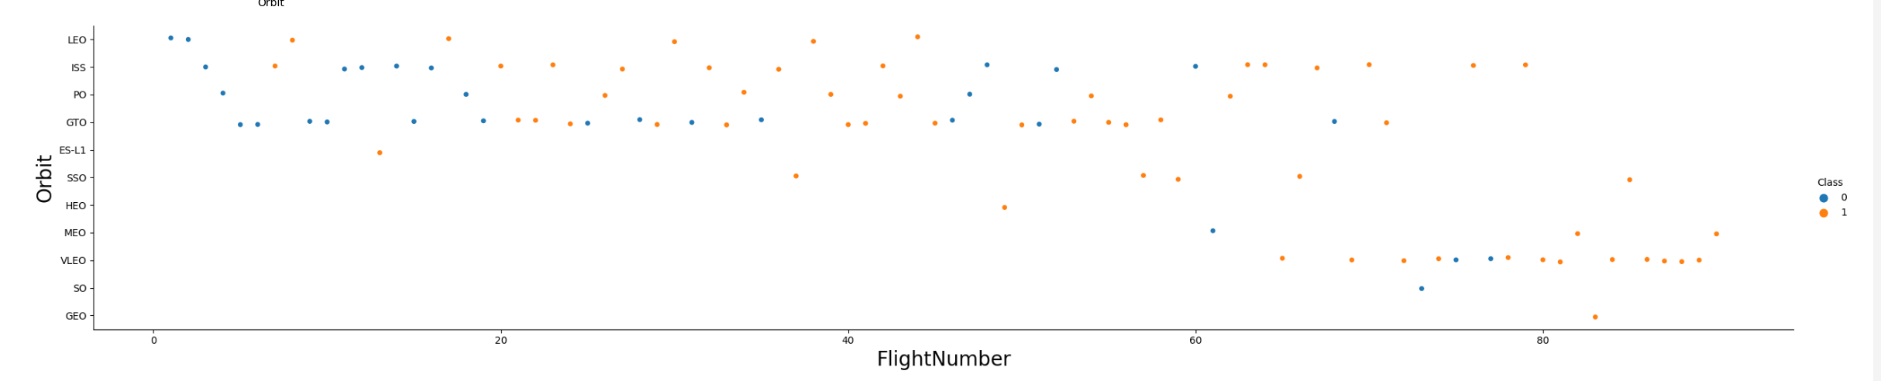
Flight Number vs. Orbit Type
Orange indicates successful launch; blue indicates unsuccessful launch.
SpaceX's preferred launch orbit has changed over time, and this preference seems to be correlated with the outcome of their missions. Initially, they focused on low Earth orbits (LEO), which had moderate success. In recent launches, they have returned to very low Earth orbits (VLEO) and have seen improved performance. It appears that SpaceX performs better in lower orbits or in Sun-synchronous orbits

Slide 22
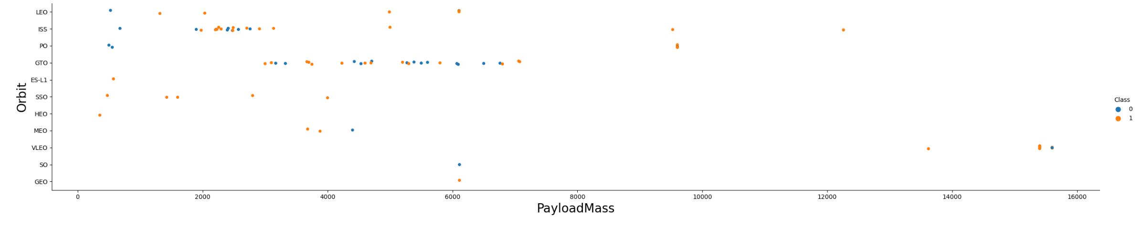
Payload vs. Orbit Type
Orange indicates successful launch; blue indicates unsuccessful launch.
The payload mass of a launch appears to be related to the orbit. LEO and SSO orbits typically have lower payload mass, while VLEO orbits tend to have higher payload mass values. The success rate of VLEO missions is also relatively high compared to other orbits.

Slide 23
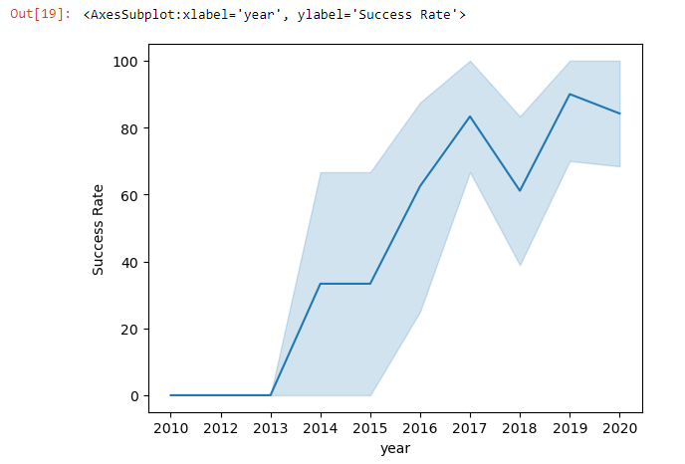
Launch Success Yearly Trend
Success has generally been increasing since 2013, with a slight dip in 2018. Currently, success rates are around 80%.

Slide 24
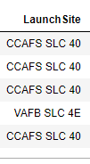
All Launch Site Names
There are likely only three unique launch site values: CCAFS SLC-40, KSC LC-39A, and VAFB SLC-4E.

Slide 25
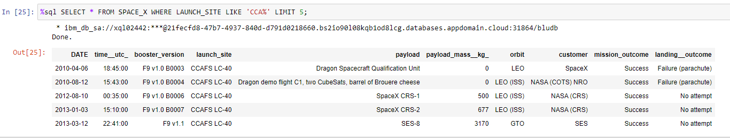
Launch Site Names Begin with 'CCA'

Slide 26
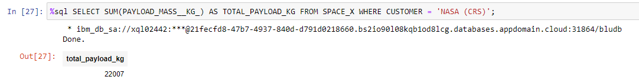
Total Payload Mass
The query calculates the total weight of payloads in kilograms that were delivered to the International Space Station (ISS) by NASA under the Commercial Resupply Services (CRS) program.

Slide 27
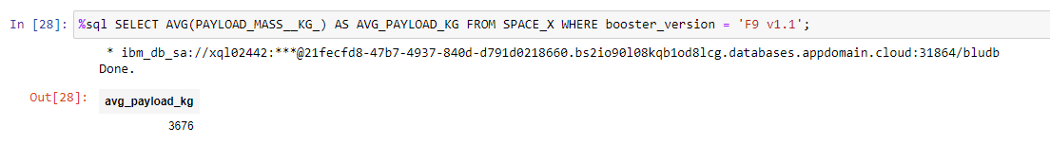
The query finds the average weight of payloads that were launched using the F9 v1.1 booster. This average is on the lower end of the payload mass range for F9 1.1.
The query finds the average weight of payloads that were launched using the F9 v1.1 booster. This average is on the lower end of the payload mass range for F9 1.1.
Average Payload Mass by F9 v1.1
The query finds the average weight of payloads that were launched using the F9 v1.1 booster. This average is on the lower end of the payload mass range for F9 1.1.

Slide 28
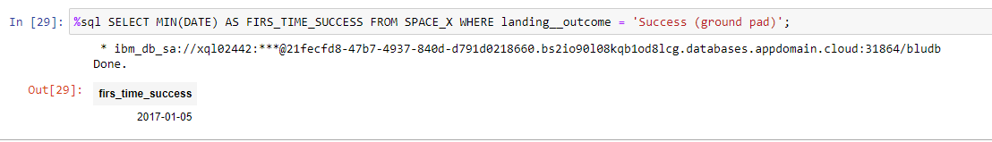
The query retrieves the date of the first successful landing on a ground pad. This milestone was achieved in 2015, although there were other successful landings starting in 2014.
First Successful Ground Landing Date
The query retrieves the date of the first successful landing on a ground pad. This milestone was achieved in 2017.

Slide 29
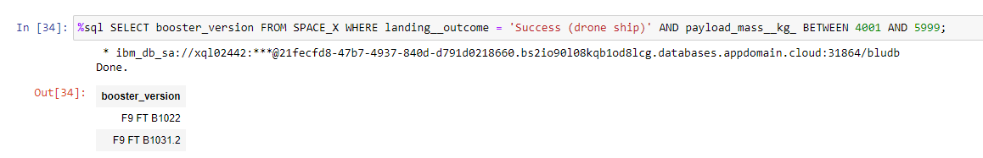
Successful Drone Ship Landing with Payload between 4000 and 6000
The query lists the two versions of boosters that successfully landed on a drone ship and carried payloads with a weight between 4000 and 6000 kilograms (non-inclusive).

Slide 30
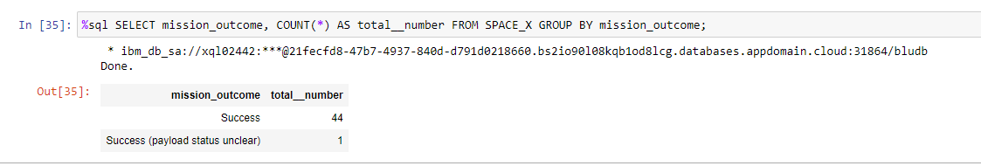
Total Number of Successful and Failure Mission Outcomes
The query returns the count of each outcome.
One launch has an unclear payload status.

Slide 31
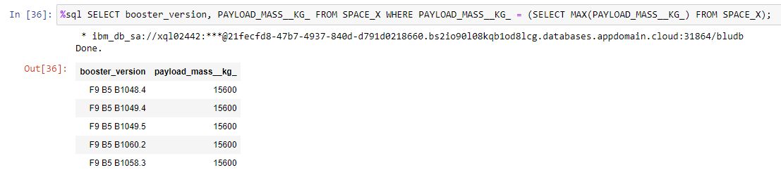
Boosters Carried Maximum Payload
The query shows the versions of boosters that carried the heaviest. These versions are part of the F9 B5 B10XX group and they are very similar. This suggests that the payload mass is correlated with the booster version used.

Slide 32
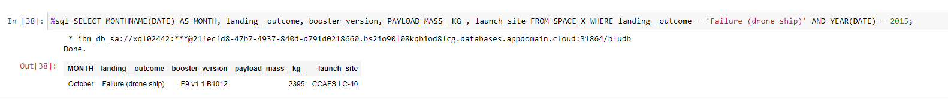
2015 Launch Records
The query shows the month, landing outcome, booster version, payload mass, and launch site of 2015 launches where the stage 1 failed to land on a drone ship.

Slide 33
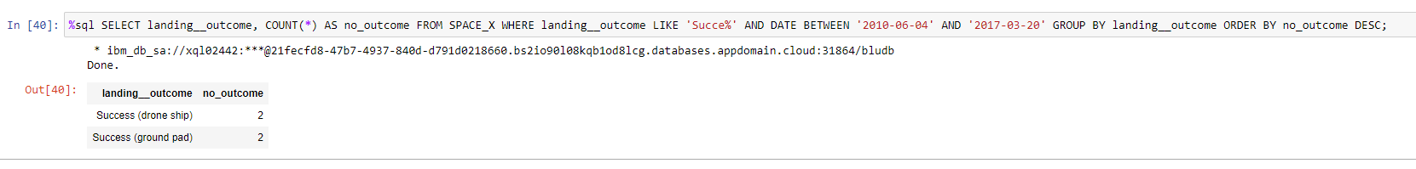
Rank Landing Outcomes Between 2010-06-04 and 2017-03-20
The query shows a list of successful landings that took place between June 4, 2010 and March 20, 2017, inclusive. There were 4 successful landings in total during this period.

Slide 34

Section 3

Slide 35
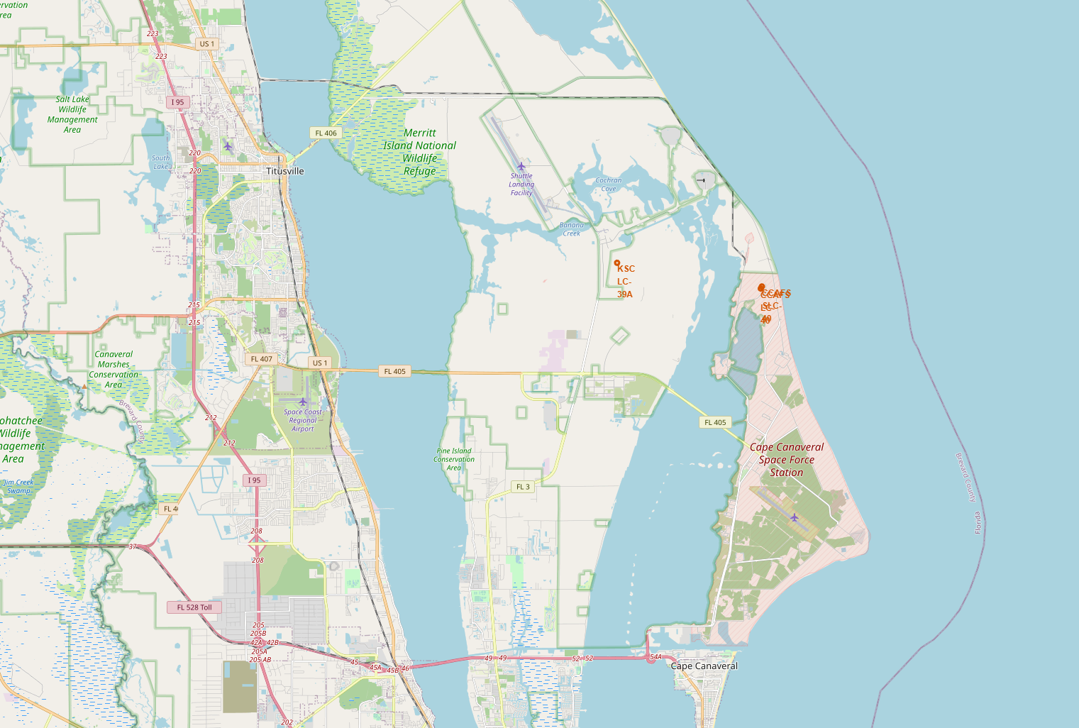
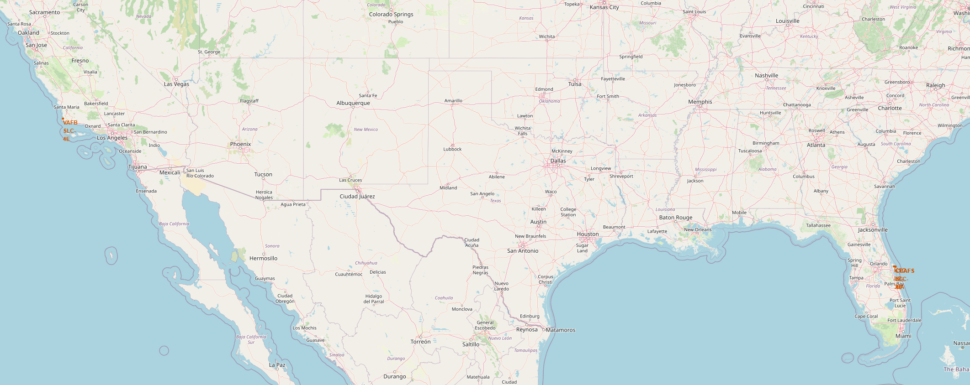
Locations: Launch sites
There right map shows the launch locations in USA and the left map the locations in Florida

Slide 36
<Folium Map Screenshot 2>
Replace <Folium map screenshot 2> title with an appropriate title
Explore the folium map and make a proper screenshot to show the color-labeled launch outcomes on the map
Explain the important elements and findings on the screenshot

Slide 37
<Folium Map Screenshot 3>
Replace <Folium map screenshot 3> title with an appropriate title
Explore the generated folium map and show the screenshot of a selected launch site to its proximities such as railway, highway, coastline, with distance calculated and displayed
Explain the important elements and findings on the screenshot

Slide 38

Section 4

Slide 39
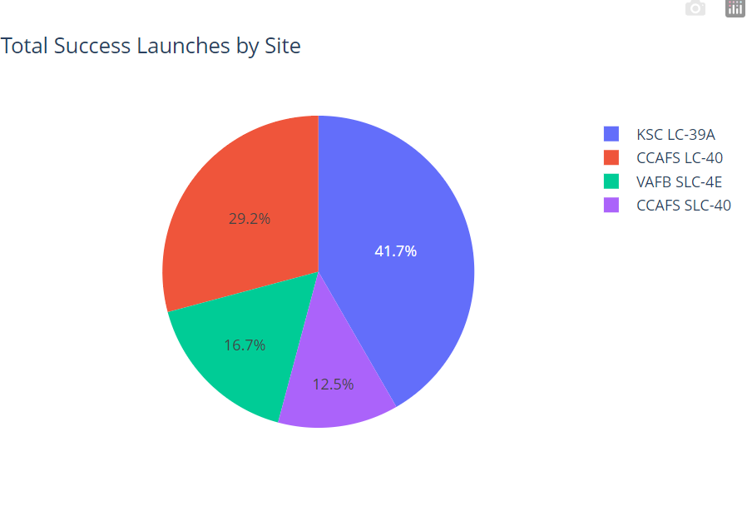
Total Succes Launches by launch site
The chart shows the number of successful landings at different launch sites. CCAFS LC-40 and CCAFS SLC-40 are the same place, so they have the same number of successful landings. Most of these landings happened before the name change. VAFB has the fewest number of successful landings. This might be because there are fewer launches from this site, or because it is harder to launch from the west coast.

Slide 40
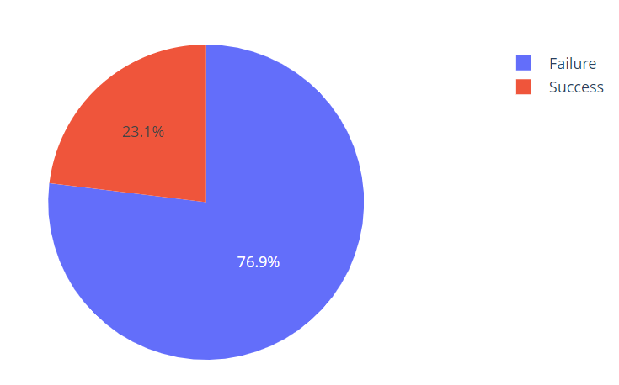
Total success launches for KSC LC-39A
This is the best success rate.

Slide 41
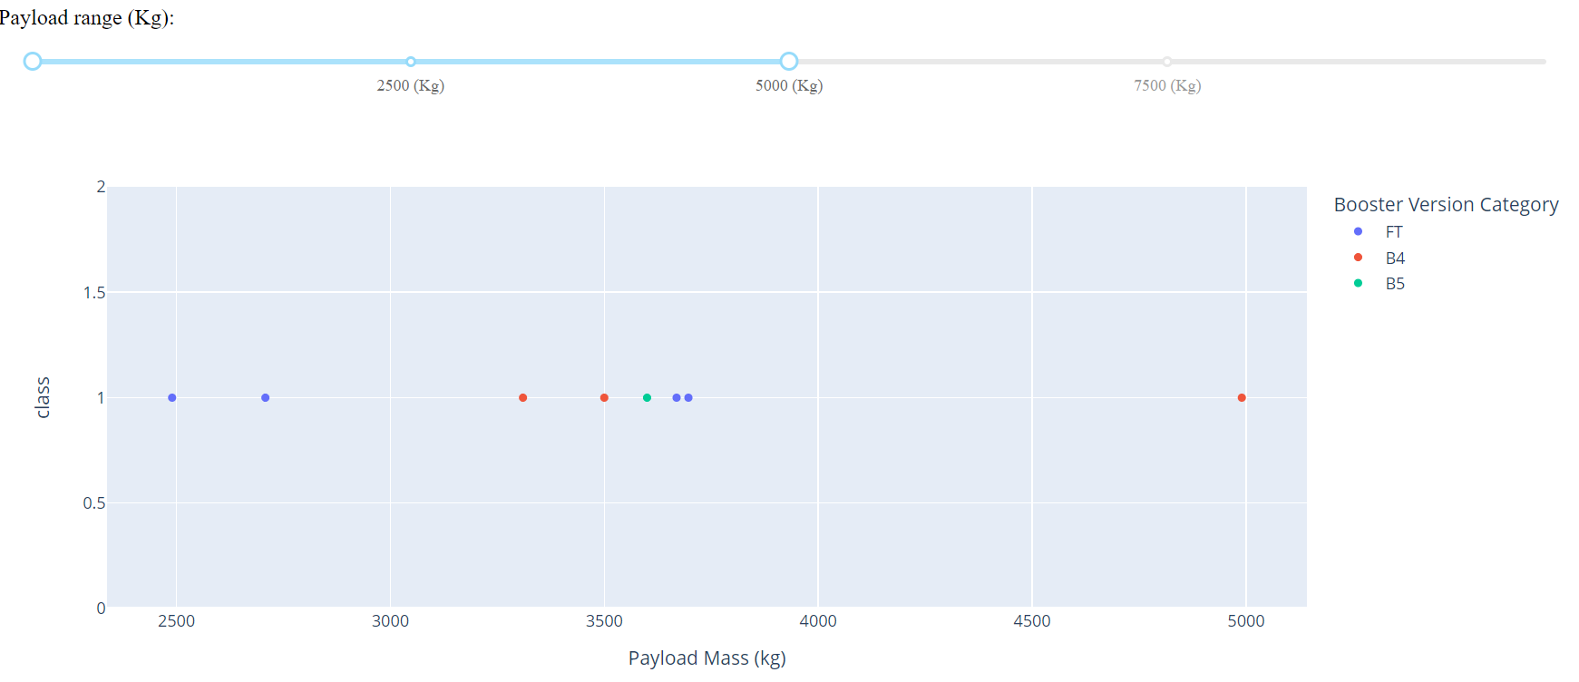
<Dashboard Screenshot 3>
With a slider we can change the range selector for the payload. In this case we have
A range from 0-5000 kg. 1 indicates a successful landing.

Slide 42

Section 5

Slide 43
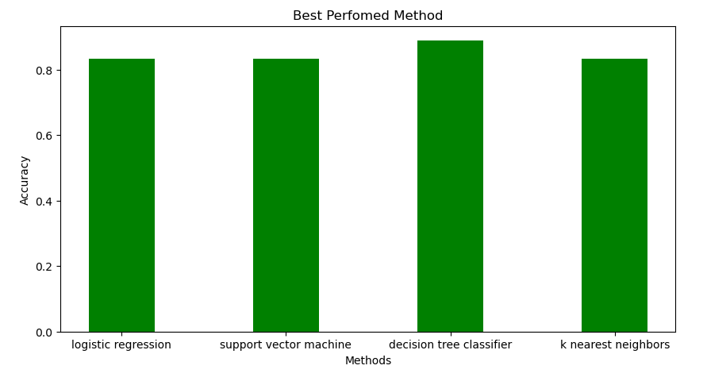
Classification Accuracy
All models have almost the same accuracy of better than 0.8. However, the decision tree classifier is the best.

Slide 44
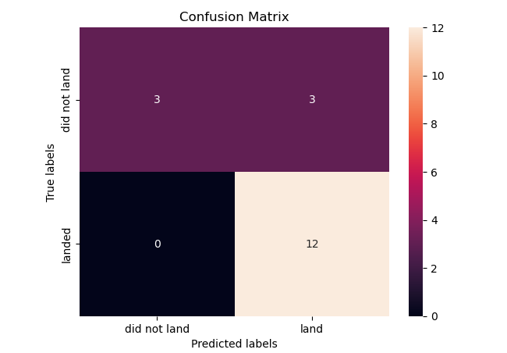
Confusion Matrix
The performance of all models on the test set was identical, so their confusion matrices are all the same. The models correctly predicted 12 landings as successful and 3 landings as unsuccessful. However, they also predicted 3 unsuccessful landings as successful (false positives), indicating that the models tend to overestimate the success rate.

Slide 45
Conclusions
More data could be used to improve the model and increase its accuracy.
We developed a machine learning model that can predict the success of a landing with an accuracy of 83%.
Allon Mask of SpaceY can use this model to decide whether a launch should go ahead.

Slide 46
Appendix
GitHub repository:

Slide 47


